Slide 1
Threaded binary Tree
Group Members:
Raunak Agrawal 03 Ayush Chandak 07 Aryan Gupta 06 Abhijit Gawai. 18

Slide 2
Defining Threaded Binary Trees • In a binary search tree, there are many nodes that have an empty left child or empty right child or both. • You can utilize these fields in such a way so that the empty left child of a node points to its inorder predecessor and empty right child of the node points to its inorder successor.

Slide 3
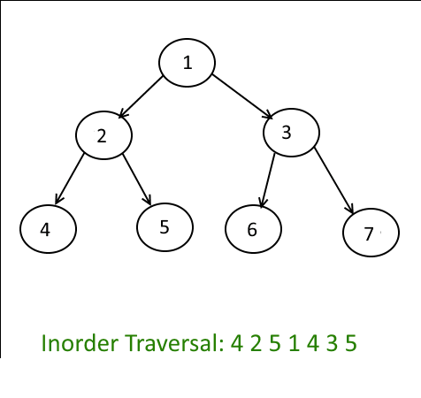
INODER
Algorithm Inorder(tree) 1. Traverse the left subtree, i.e., call Inorder(left-subtree) 2. Visit the root. 3. Traverse the right subtree, i.e., call Inorder(right-subtree)

Slide 4
Threaded binary Tree • One way threading:- A thread will appear in a right field of a node and will point to the next node in the inorder traversal. • Two way threading:- A thread will also appear in the left field of a node and will point to the preceding node in the inorder traversal.

Slide 5
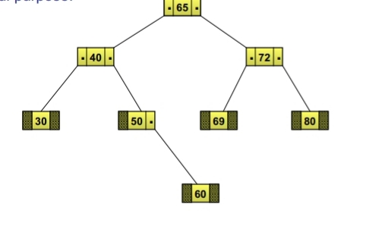
Defining Threaded Binary Trees
•Consider the following binary search tree
•Most of the nodes in this tree hold a NULL value in their left or right child
fields
•In this case, it would be good if these NULL fields are utilized for some other useful purposes

Slide 6
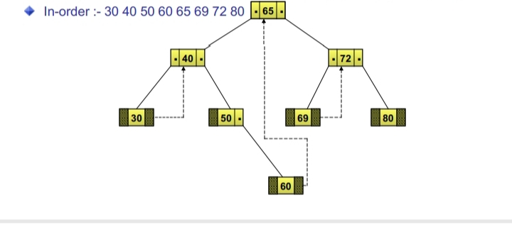
One Way Threaded Binary Trees
1. The empty left child field of a node can be used to point to its inorder predecessor.
2. Similarly, the empty right child field of a node can be used to point to its in-order successor.
3. Such a type of binary tree is known as a one way threaded binary tree.
4.A field that holds the address of its in-order successor is known as thread. In-order :- 30 40 50 60 65 69 72 80

Slide 7
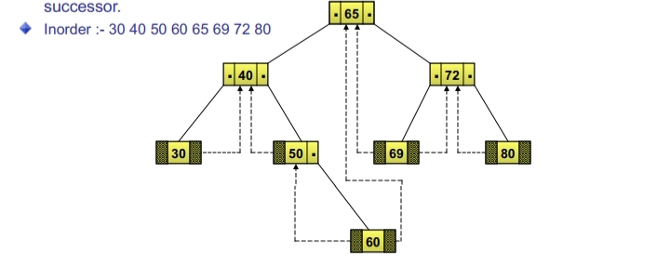
Two way Threaded Binary Trees
1.Such a type of binary tree is known as a threaded binary tree.
2. A field that holds the address of its inorder successor or predecessor is known as thread.
3. The empty left child field of a node can be used to point to its inorder predecessor.
4. Similarly, the empty right child field of a node can be used to point to its inorder
successor. Inorder :- 30 40 50 60 65 69 72 80

Slide 8
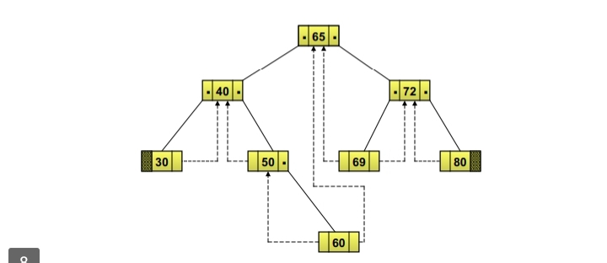
4. Node 30 does not have an inorder predecessor because it is the first node to be traversed in inorder sequence.
5. Similarly, node 80 does not have an inorder successor

Slide 9
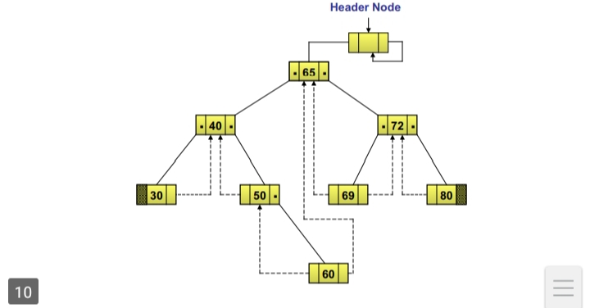
Two way Threaded Binary Trees with header Node
1.The right child of the header node always points to itself.
2. Therefore, you take a dummy node called the header node.

Slide 10
3.The threaded binary tree is represented as the left child of the header node

Slide 11
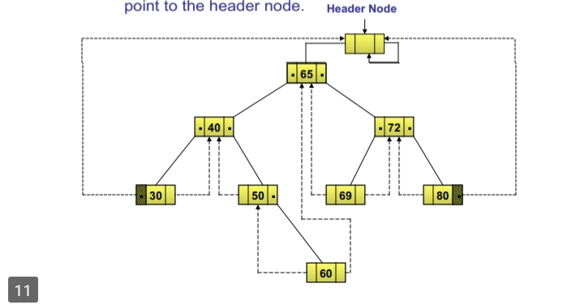
4.The left thread of node 30 and the right thread of node 80 point to the header node.

Slide 12
Representing a Threaded Binary
1. Tree The structure of a node in a threaded binary tree is a bit different from that of a normal binary tree. Unlike a normal binary tree, each node of a threaded binary tree contains two extra pieces of information, namely left thread and right thread.
2.The left and right thread fields of a node can have two values: 1: Indicates a normal link to the child node 0: Indicates a thread pointing to the inorder predecessor or inorder successor

Slide 13
Advantages of threaded binary tree:
1. Any node can be accessible from any other node. Threads are usually more to upward whereas links are downward. Thus in a threaded tree, one can move in their direction and nodes are in fact circularly linked. This is not possible in unthreaded counter part because there we can move only in downward direction starting from root.
2. Insertion into and deletions from a threaded tree are although time consuming operations but these are very easy to implement.

Slide 14
Disadvantages of threaded binary tree:
1. Insertion and deletion from a threaded tree are very time consuming operation compare to non-threaded binary tree.
2. This tree require additional bit to identify the threaded link.

Slide 15
struct node *insert(struct node *root, int ikey) { struct node *tmp, *par, *ptr: int found = 0; ptr = root; par = NULL; while (ptr!=NULL) { if(ikey == ptr->info) { found = 1; break; } par=ptr; if(ikey<ptr->info) { if(ptr->lthread==false) ptr = ptr->left; else break; }
//done till here to delte this line } if(found) printf("Duplicate key"); else { tmp=(struct node *)malloc(sizeof(struct node)); tmp->info = ikey; tmp->lthread = true; tmp->rthread = true; } if(par==Null) { root =tmp; tmp->left = NULL; tmp->right = NULL; } else if(ikey < par->info) { tmp->left = par->left; tmp->right = par; par->lthread = false; par->left = tmp; }

Slide 16
else { tmp->left = par; Emp->right = par->right; par->rthread = false; par->right = tmp; } } return root; } else if tinley < park->info) mp->left = far->left: };

